Slide 1


Our data approach to help Australia achieve net zero Carbon footprint target by 2050

Slide 2
1
Problem Statement

Slide 3



Our problem statement to understand Australia’s Carbon footprint challenge
Australia targets to achieve its Net-zero target carbon footprint by 2050. We thrive to utilise data sources across different stakeholders such as governments at federal and state level, businesses and individuals. We thrive to build consolidated visualisations around Australia and global ESG data
Our main focus for this initiative is on three particular industries including
Transportation
Construction and Manufacturing
Waste Management
We have utilised a 5 step data approach to approach our pipeline from data collection to analysis and visualization.
We present our insights as a dashboard
We have used data sets from Australian and International bodies to conduct our analysis
We have developed a proof-of-concept to test the concept of social and green initiatives
Source: Carbon footprint calculation - Carbon footprint calculation is part of life-cycle assessment
Note: All the utilized data sets are highlighted on our team’s GitHub website

Slide 4
2
The ‘What’

Slide 5
What does carbon footprint mean for you
Carbon footprint for an organisation
Carbon footprint is a significant measure of organisations and individuals impact on the environment
Indirect indicator of the consumption of energy, products, and services
Measures the amount of carbon footprint which corresponds to a company’s activities or products
Carbon footprint for a product
The carbon footprint of a product includes greenhouse gas emissions produced during a product’s life cycle, from extraction of raw materials up to waste disposal.
We have considered the GHG Protocol for carbon footprint measurement and reporting
Scope 1 – Direct GHG Emissions
Scope 2 – Indirect GHG Emissions
Scope 3 – Other GHG Indirect emissions
Emissions that are released directly into the air generated by activities controlled or owned by an organisation
Some examples include Emissions from boilers, furnaces, or generators burning fossil fuels, motor vehicles, industrial processes, waste water treatment
Emissions that are not generated directly at the organisation, but are the result of the company’s activities
Organisation has a significant influence on the size of emissions
Emissions resulting from the company’s activities which are outside the company’s control or ownership
Some examples include business travel, waste disposal, purchase and transport of material by a third party
Source: Carbon footprint calculation - Carbon footprint calculation is part of life-cycle assessment

Slide 6
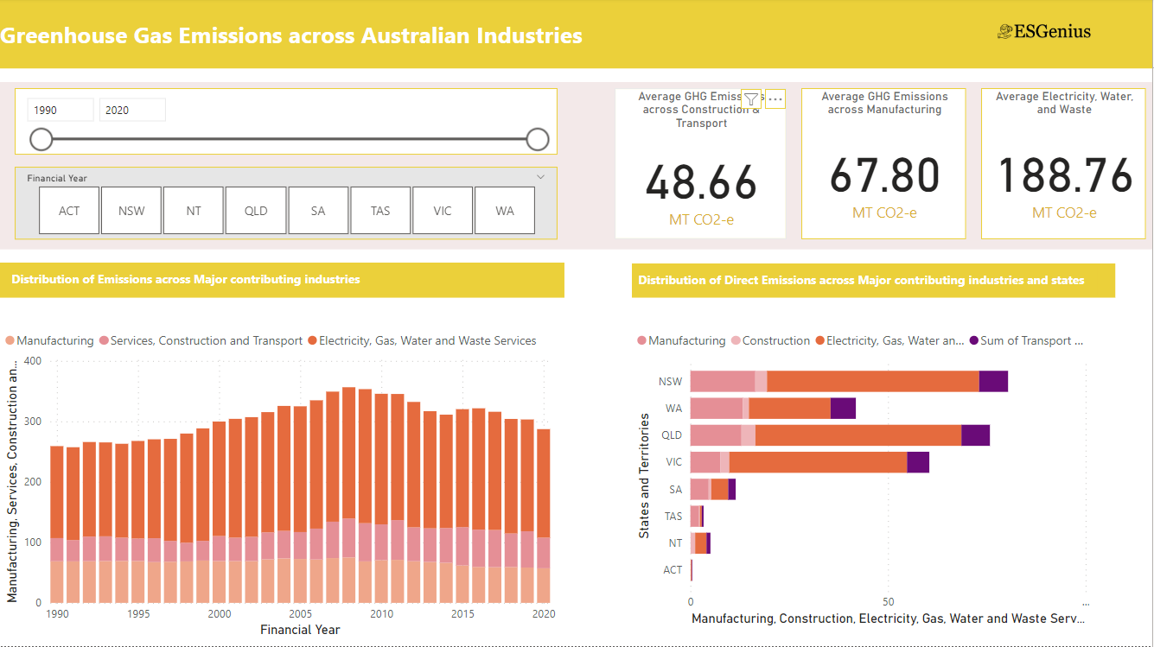
Track Emissions across Australian states and industries
Decarbonisation is about reducing CO₂ emissions resulting from human activity, with eventual goal of eliminating them.
The 2015 Paris Agreement set an ambition to limit global warming to well below 2°C above pre-industrial levels and pursue efforts to limit it to 1.5°C - in part by pursuing net carbon neutrality by 2050. The substantial reduction of global greenhouse gas emissions (including CO₂) will limit the increase of global temperature.
Australian Industries considered for tracking Greenhouse Gas emissions across the decade
Construction
Transportation
Waste Management
Source: Deloitte: What is Decarbonisation?

Slide 7
3
The ‘Why’

Slide 8




Current challenges experienced around the ESG data process across governments and organisation
Lack of Single source of data
The organisational ESG data across representing its direct and indirect emissions in stored across isolated data sources. This may lead to redundancy across the data sources and induce complexity around reporting.
Increase in unstructured data sources
There has been a rise in amount of unstructured ESG data stored across different organisational departments that poses challenges in data processing and analysis.
Variations across data standards
There has been a rise in amount of unstructured ESG data stored across different organisational departments that poses challenges in data processing and analysis.
Lack of data skills
Consolidation of data sources across Government, organisation and individuals requires integrated skills across data and cybersecurity

Slide 9
4
The ‘How’

Slide 10



Data Approach and Methodology to our ESG problem
Government
Individuals
Businesses
Data Sources
Your ESG data is stored across government departments, businesses and individuals. These sources are generally used for extraction of data
Data Collection
Data is ingested from various data sources. This data may be unstructured, semi-structured or unstructured
Data Processing
Your data is validated for any errors, cleaned and transformed for further processing
Data Storage
The data is stored in large data storages such as large data warehouses and data lakes ready for analysis
Data Visualisation
We perform predictive analysis and visualisation on ESG metrics across Australia. This can help to track and comply with relevant legislations
Data Governance and Monitoring

Slide 11
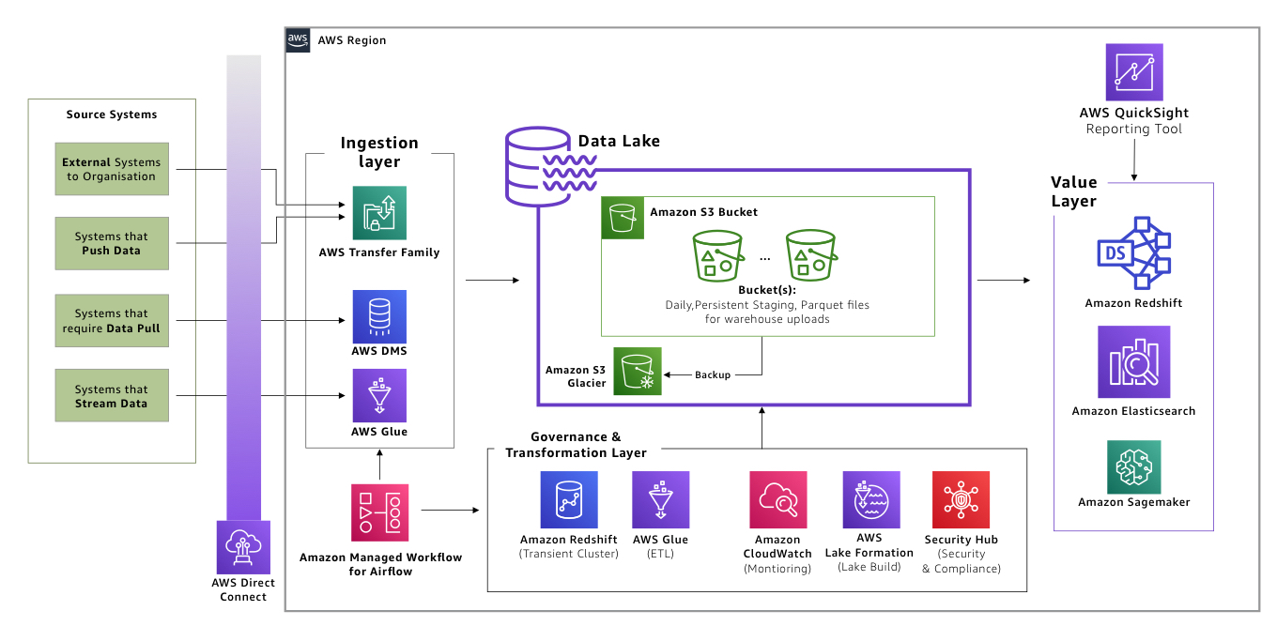
We have utilized AWS Data architecture to develop a single source of truth across ESG data
Data Sources
Data Collection
Data Processing
Data Analytics
Transportation
Data Sets Utilised: Australian Government -State & Federal, OECD, World Bank
Source: AWS data architecture

Slide 12
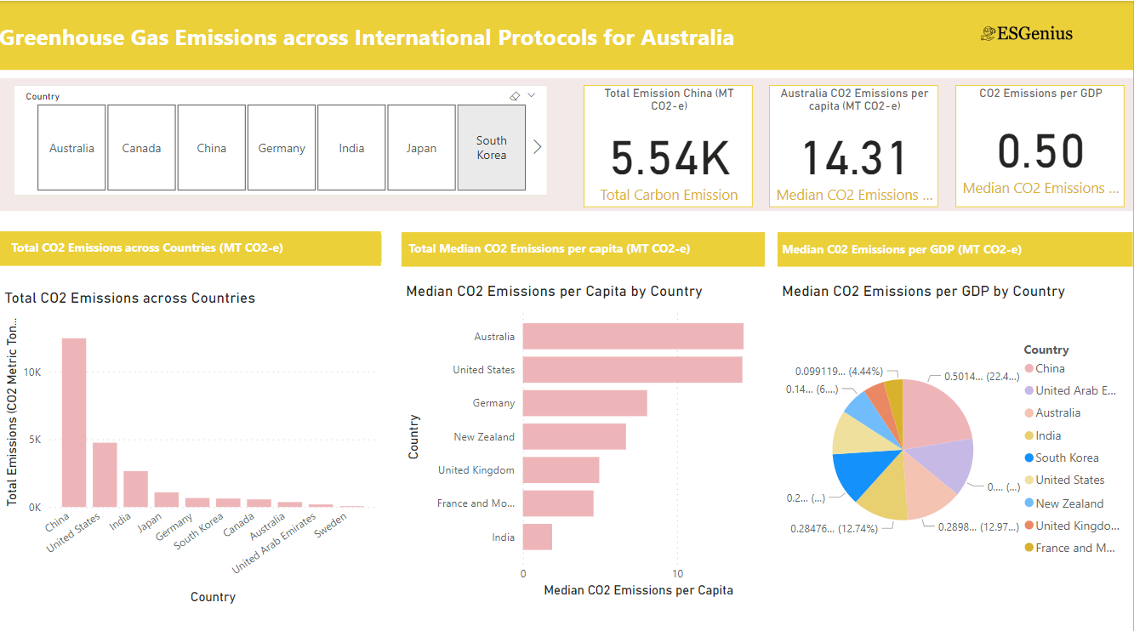
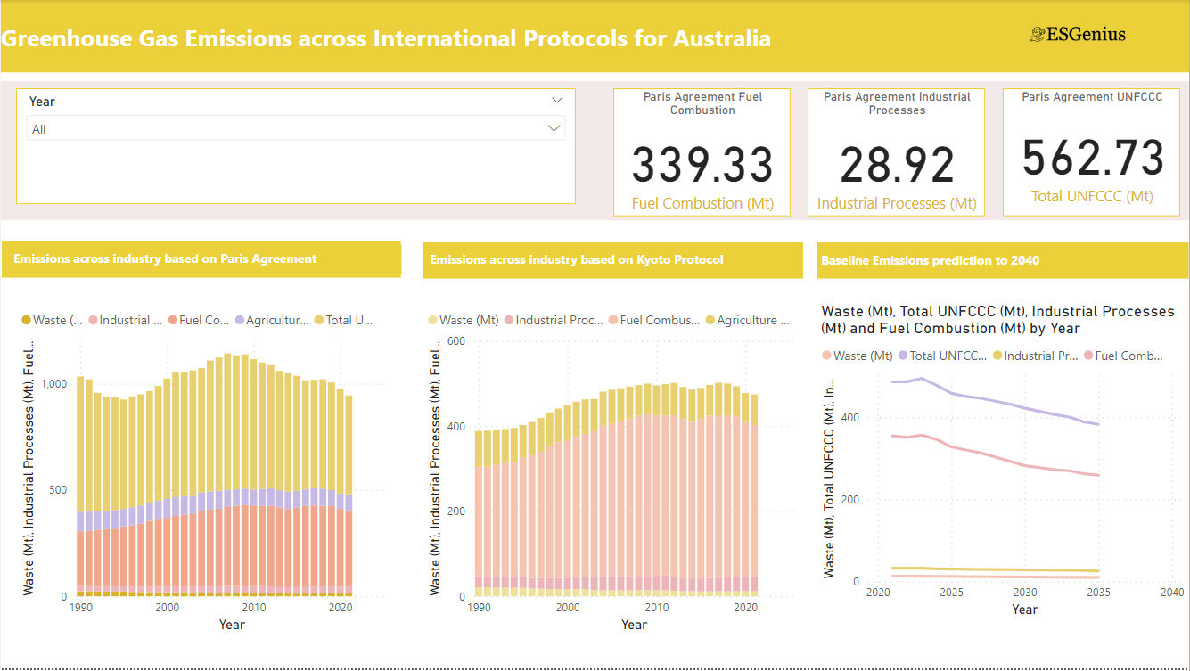
We have developed ESG dashboards across Australian states and different industry to provide overview of our impact
We have considered CO2 emission across three industries
Transportation
Waste Management
Construction
Our analysis compares Australian carbon footprint across the globe
Compliance with International Climate protocols
Comparison based on GDP and per Capita figures
The Dashboard also forecasts Australia’s carbon neutral journey and track its performance goals by 2050

Slide 13
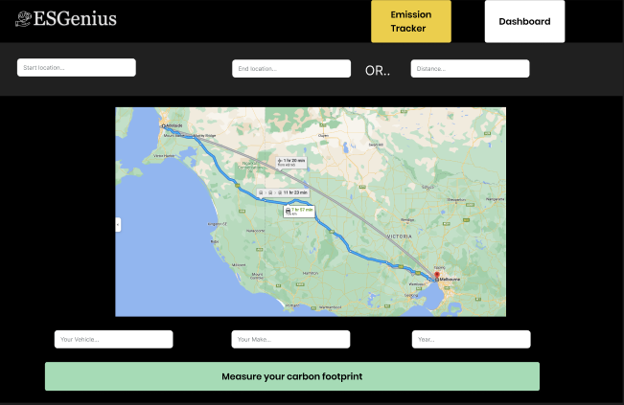
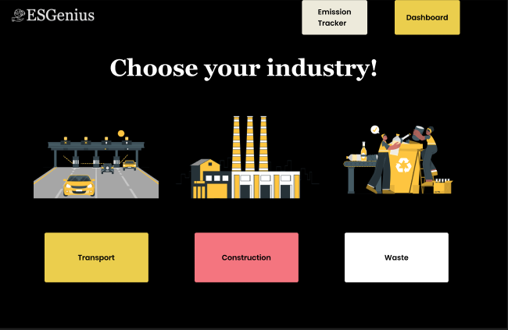
We have developed a proof-of-concept to highlight the key social and green incentive to reducing carbon footprint
Consideration for different stakeholders including
Government
Businesses
Individuals
We have compared traditional modes of transport (non-electric car) to other cleaner modes
Direct Emissions
Indirect Emissions
We have proposed green benefits to the stakeholders making a positive impact on the environment
We also highlight financial benefits in switching to alternative means of transport

Slide 14
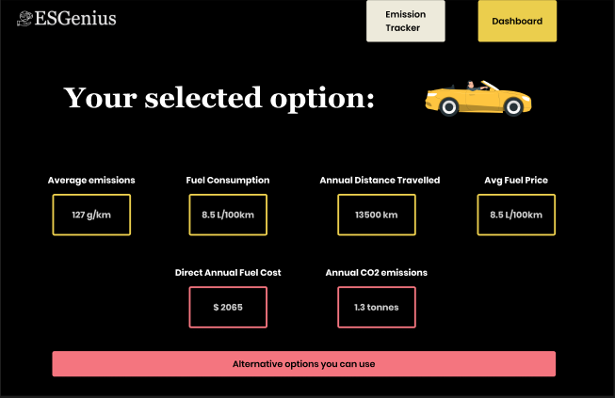
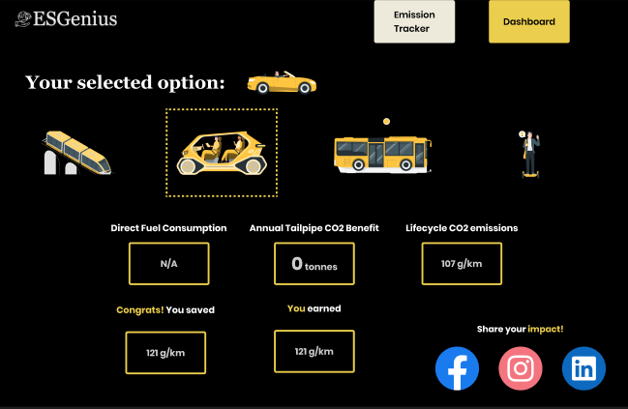
Incentives to reduce GHG emissions
We have proposed green benefits to the stakeholders making a positive impact on the environment
We also highlight financial benefits in switching to alternative means of transport
We have highlighted carbon reduction through alternative data sources
Carbon footprint impact based on alternative sources – financial and green incentives linked through social media

Slide 15
Decarbonisation strategies
01
02
03
Transition to green
Market mechanisms
Ensuring a smooth transition
By planning for a sustainable future governments are able to proactively influence projects that :
Shifting reliance on fossil fuels for electricity generation and to more sustainable energy sources
Increasing clean energy will allow for a rapid transition to electrification that can increase access to the clean energy supply and displace unclean energy sources
Improving energy efficiency to reduce demand
Ensuring that natural sources storing carbon remain effective, through forest and land management practices
With all of the above it imperative that we act sooner rather than later as it helps to avoid lock-ins and is more cost effective.
Governments are able to use market base instruments to put a price on carbon emitting activities, these strategies work as they influence an actors’ behaviors by changing the incentive structures. This can take the form of a Emissions trading system, there is a cap on the total amount of emissions and issues permits. Companies are incentivised to reduce there carbons emissions as they are able to sell there allocation if they emit less.
Additionally, other levers such as tax incentives, performance requirements and rebates have been effective reducing emissions.
Public buy in will be required to ensure a smooth transition as lower socioeconomic areas of the economy are still more heavily reliant on fossil fuels. However, this process needs to be carefully managed as current fossil fuel subsidies benefit primarily the rich.
Source: World Bank, Decarbonizing Development: Three Steps to a Zero Carbon Future, 2015

